Slide 1

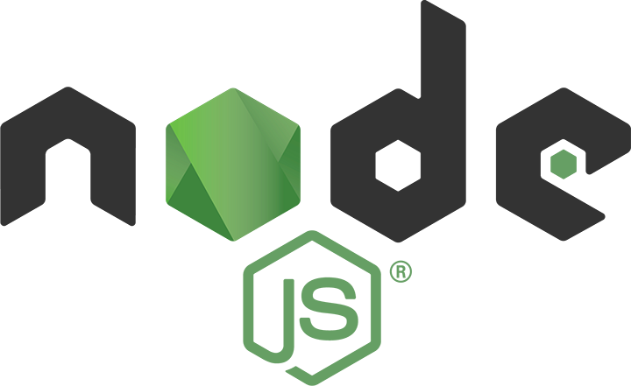
Dev-Pro Node.js
Advanced Flow
Lesson 5. Clusters and multiprocessing. PM2.

Slide 2

Agenda:
Scaling Node.js application
Child process events
The shell syntax
The fork() function
The cluster module

Slide 3

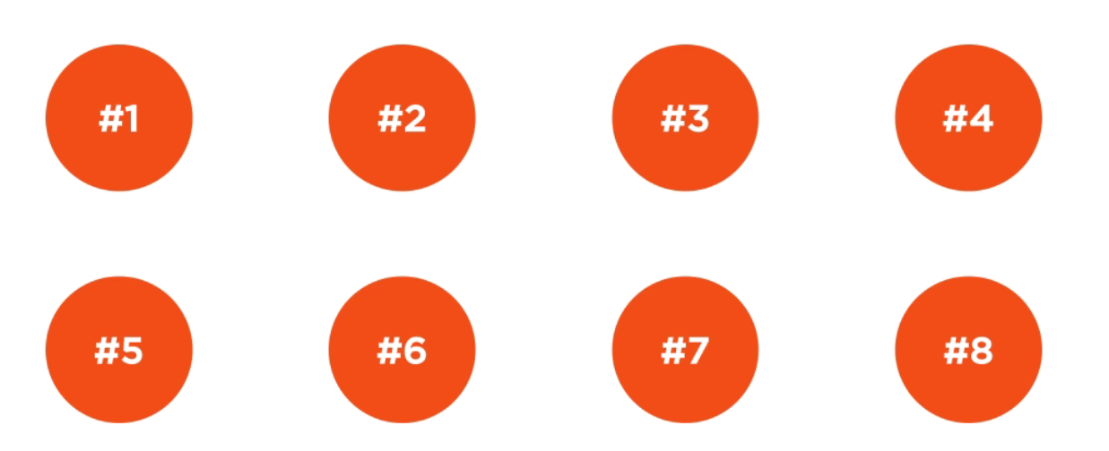
Why node call node?

Slide 4
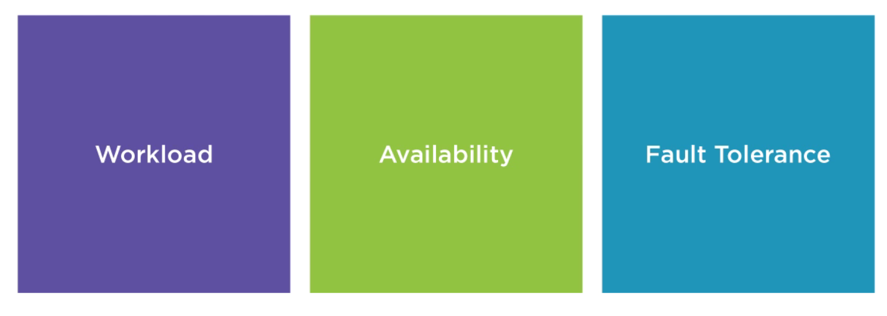
Scalability

Slide 5
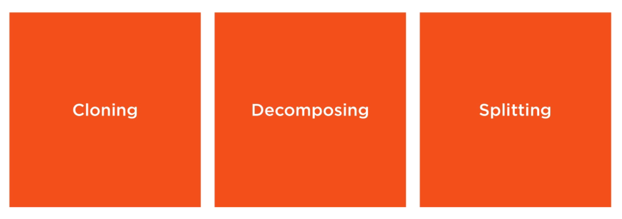
Scalability Strategies

Slide 6
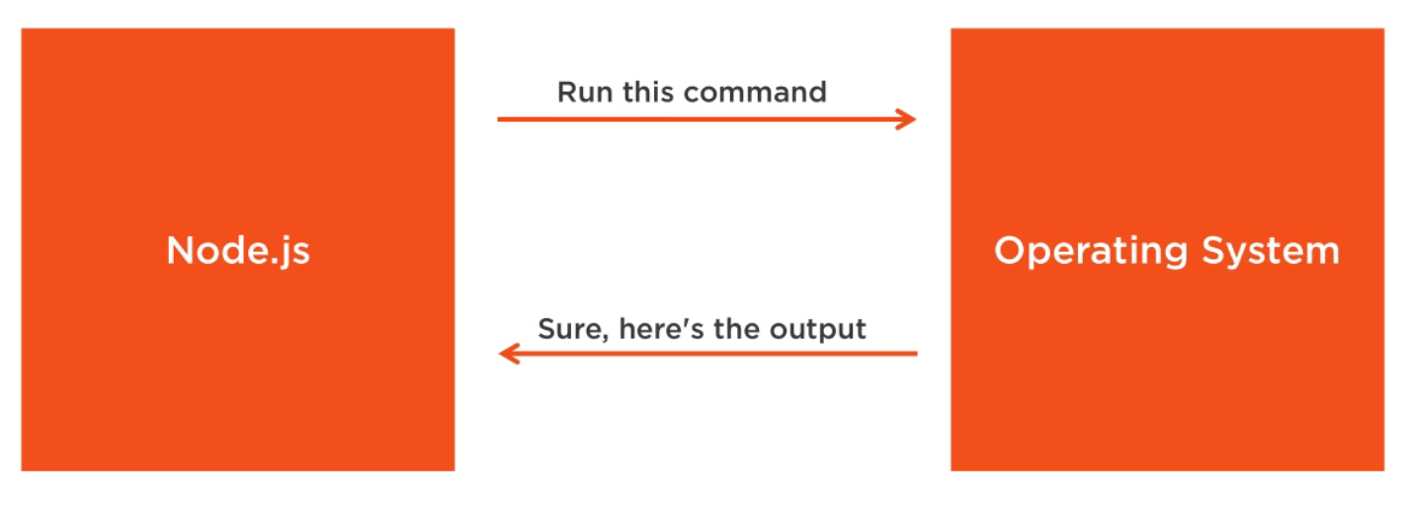
Node.js and the OS

Slide 7
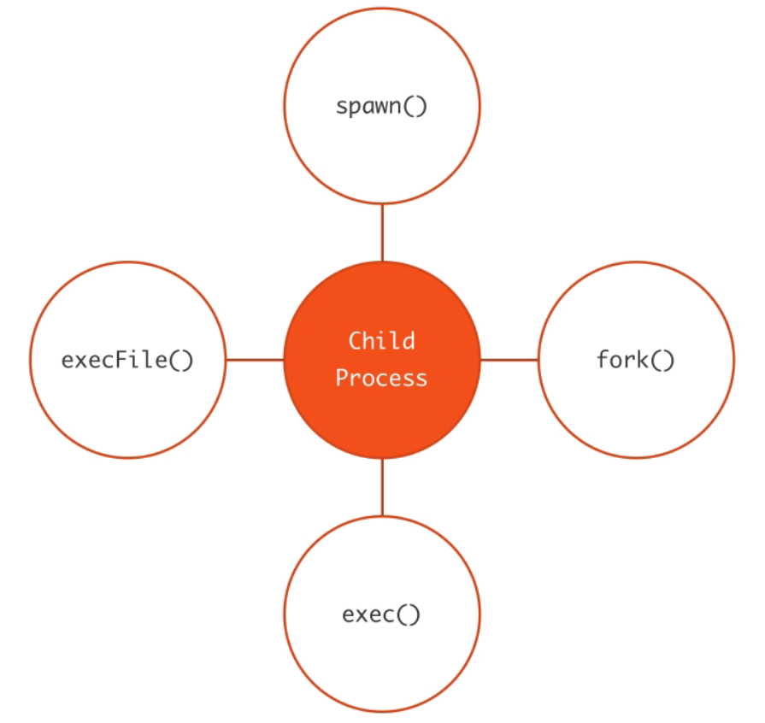
Child process

Slide 8
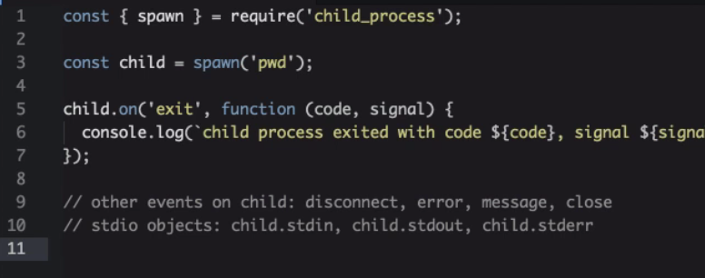
Spawn

Slide 9
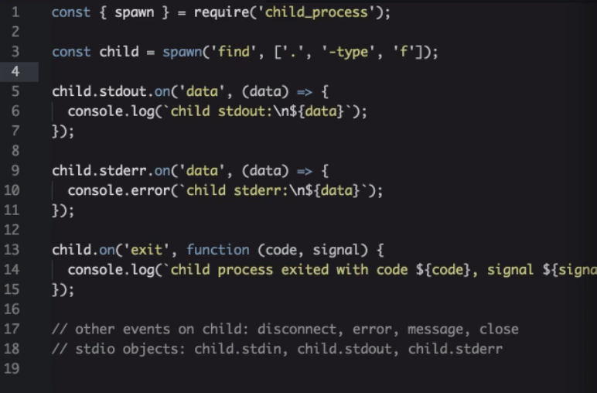
Spawn

Slide 10
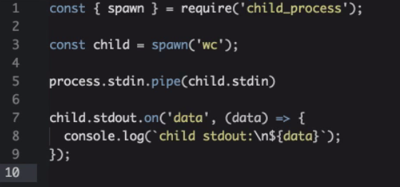
Spawn-Pipe

Slide 11
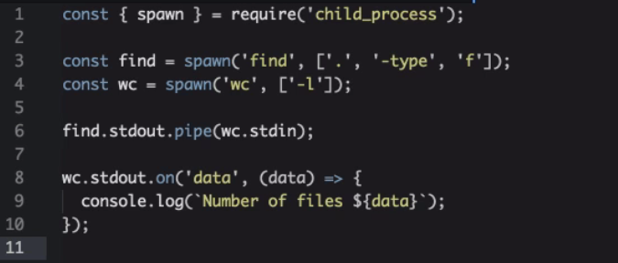
Spawn

Slide 12
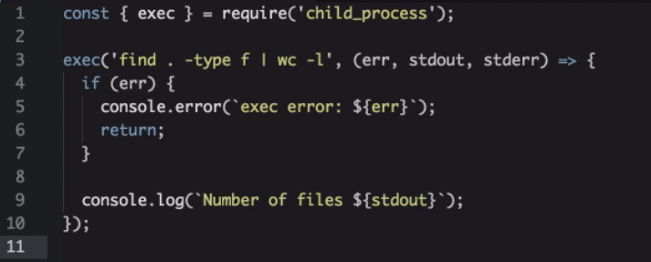
Exec

Slide 13
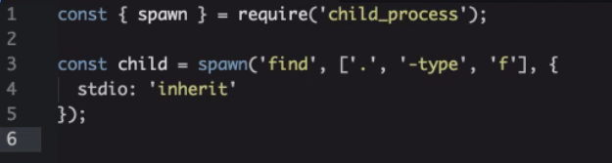
Exec inherit

Slide 14
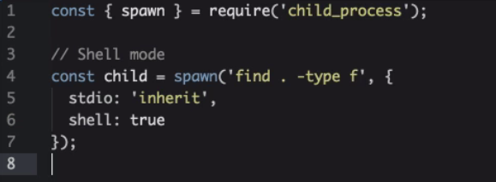
Exec shell

Slide 15
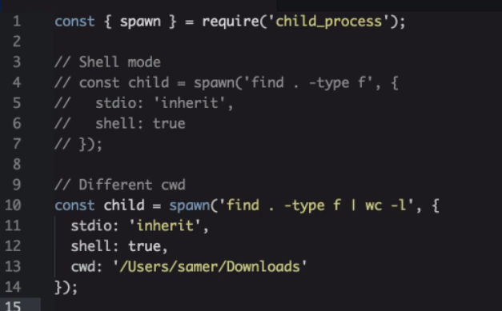
Exec cwd

Slide 16
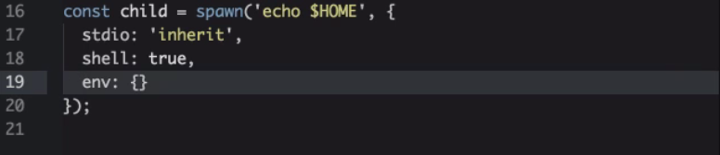
Exec isolate env

Slide 17
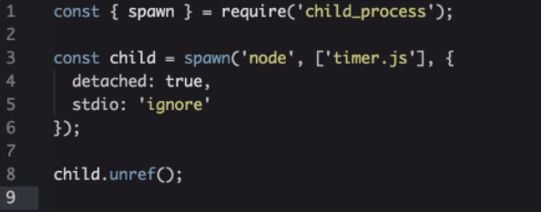
Exec Independent Child Process

Slide 18
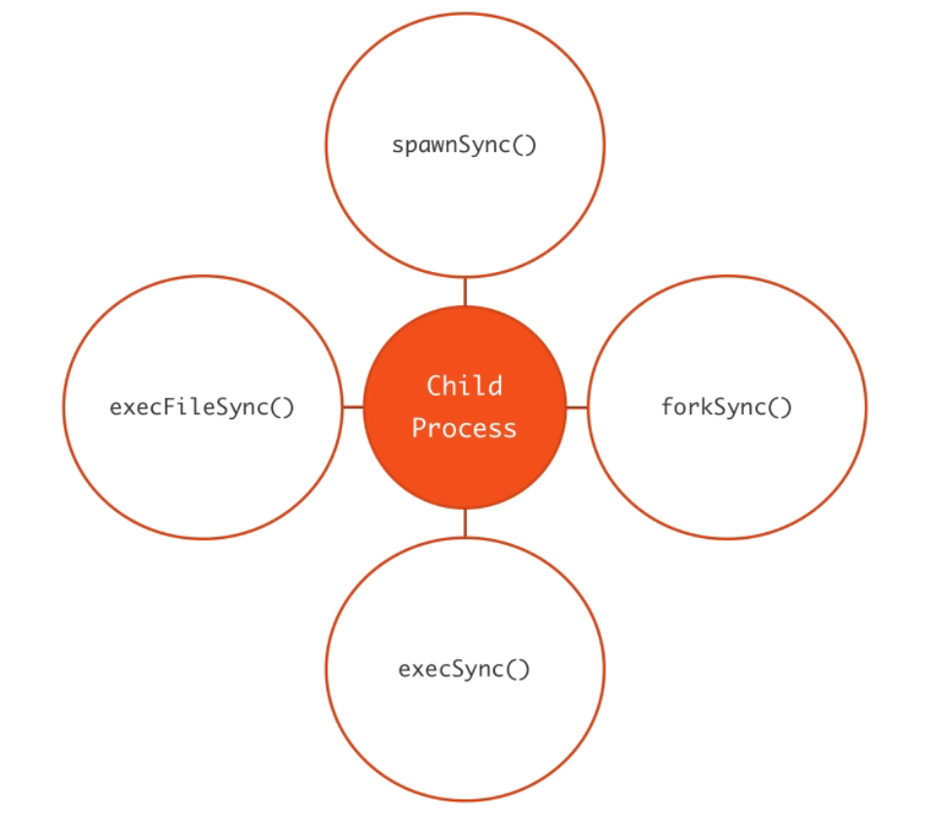
Blocking versions

Slide 19
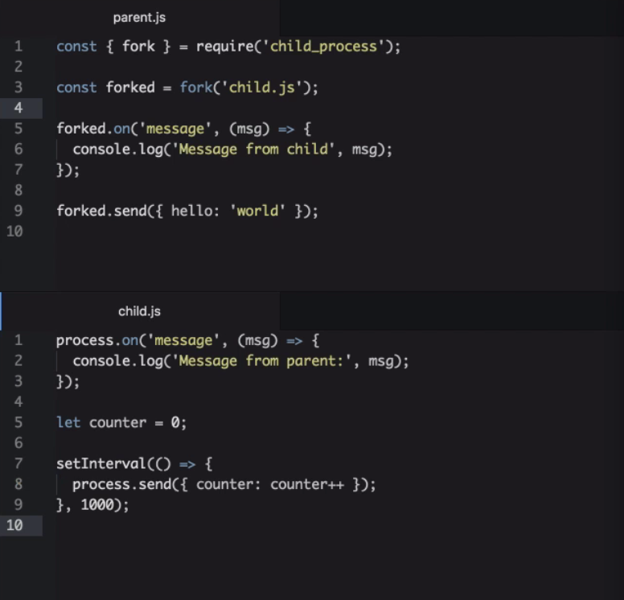
Fork

Slide 20
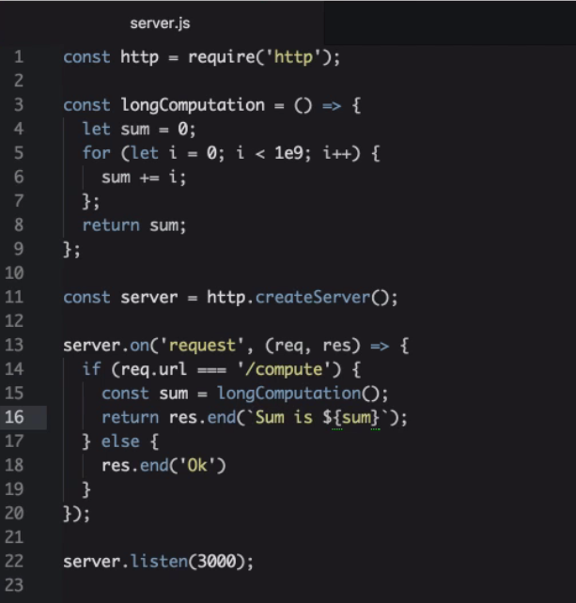
Practical example… What if?

Slide 21
Practical example… What if?

Slide 22
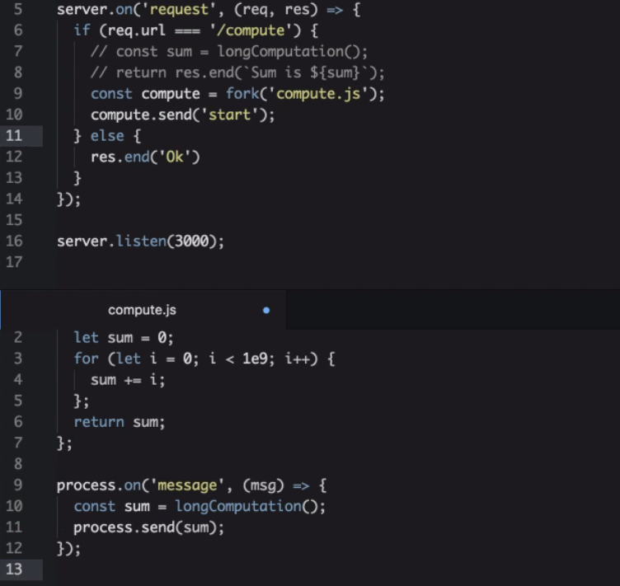
Practical example…

Slide 23

When you have multiple CPUs

Slide 24
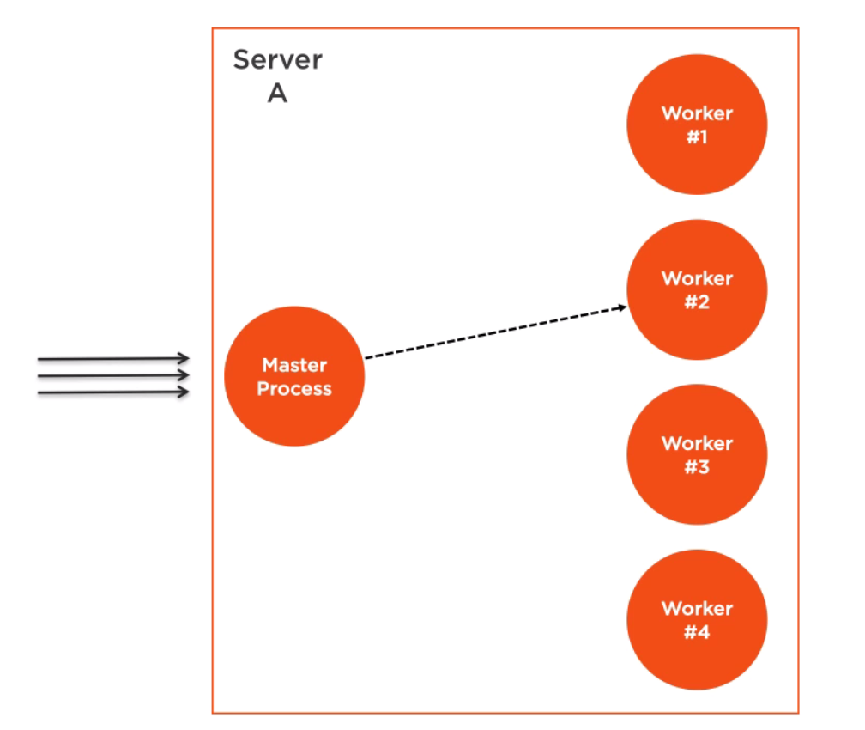
Clustering

Slide 25
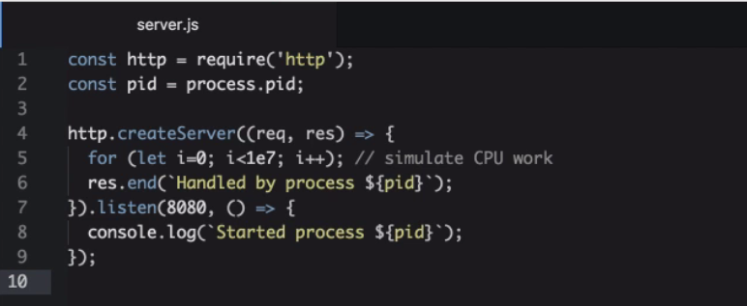
Define server

Slide 26
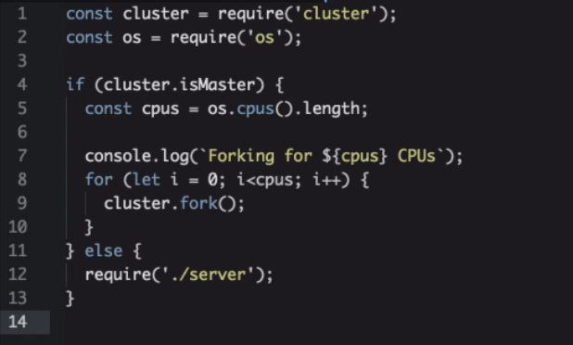
Clustering

Slide 27
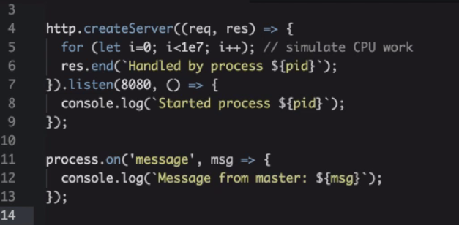
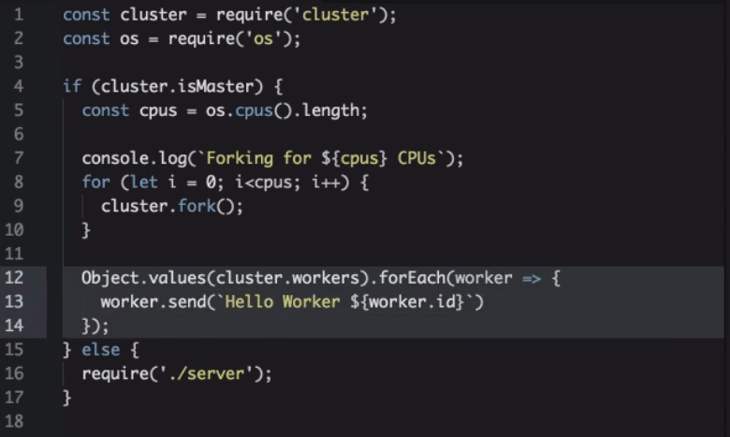
Clustering broadcasting

Slide 28
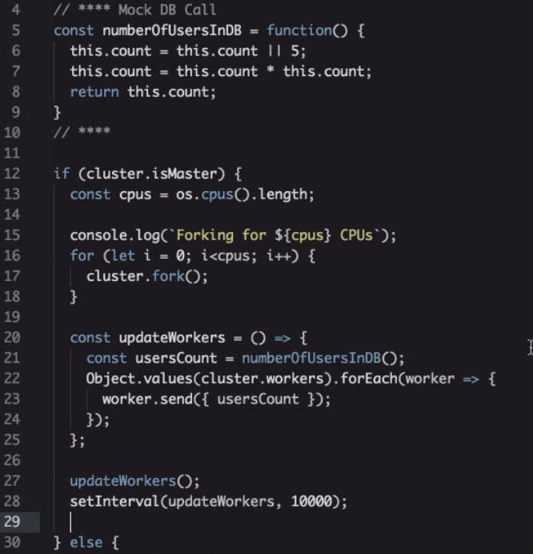
Clustering

Slide 29
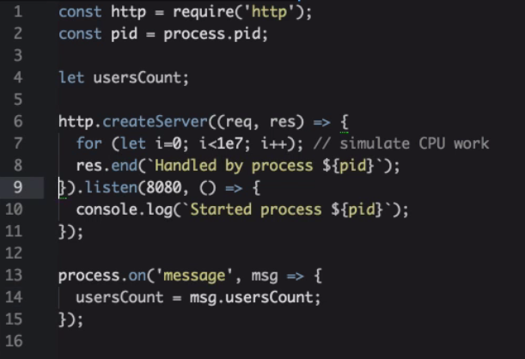
Clustering

Slide 30
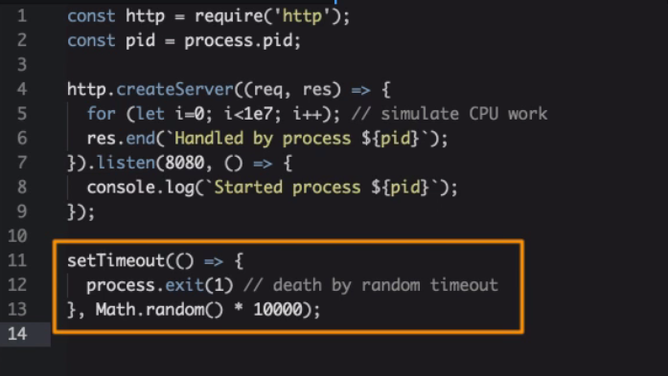
Zero downtime

Slide 31
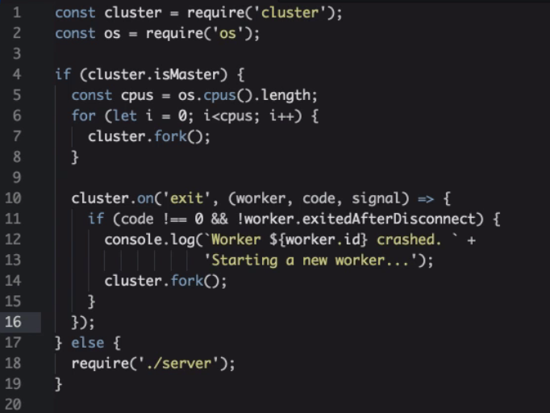
Zero downtime

Slide 32
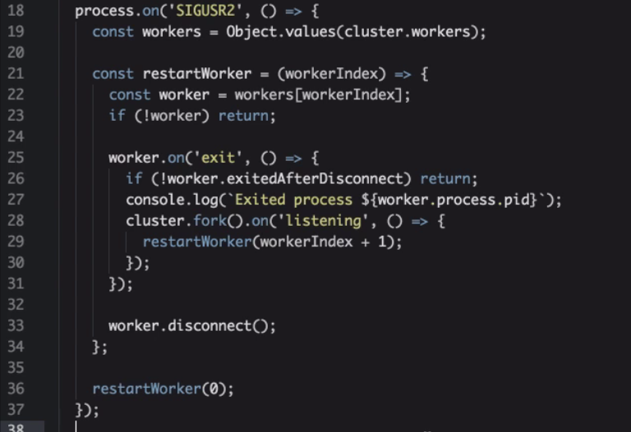
Restart all workers with Zero Downtime

Slide 33
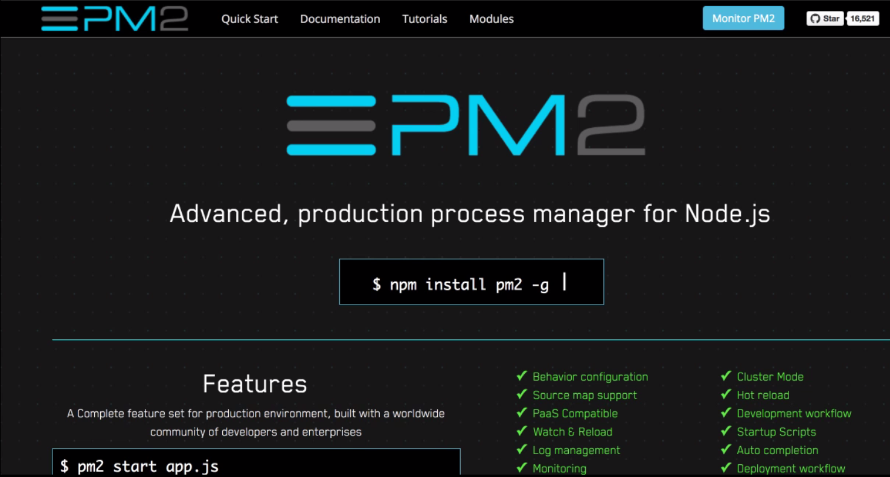
PM2

Slide 34
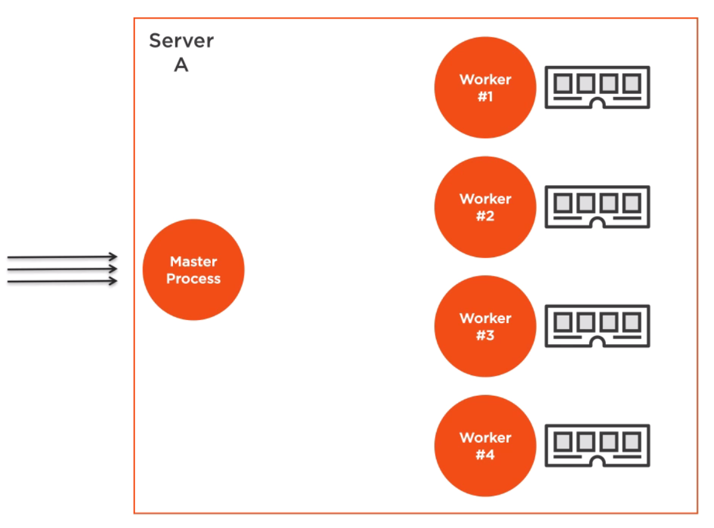
Non-Shared state

Slide 35
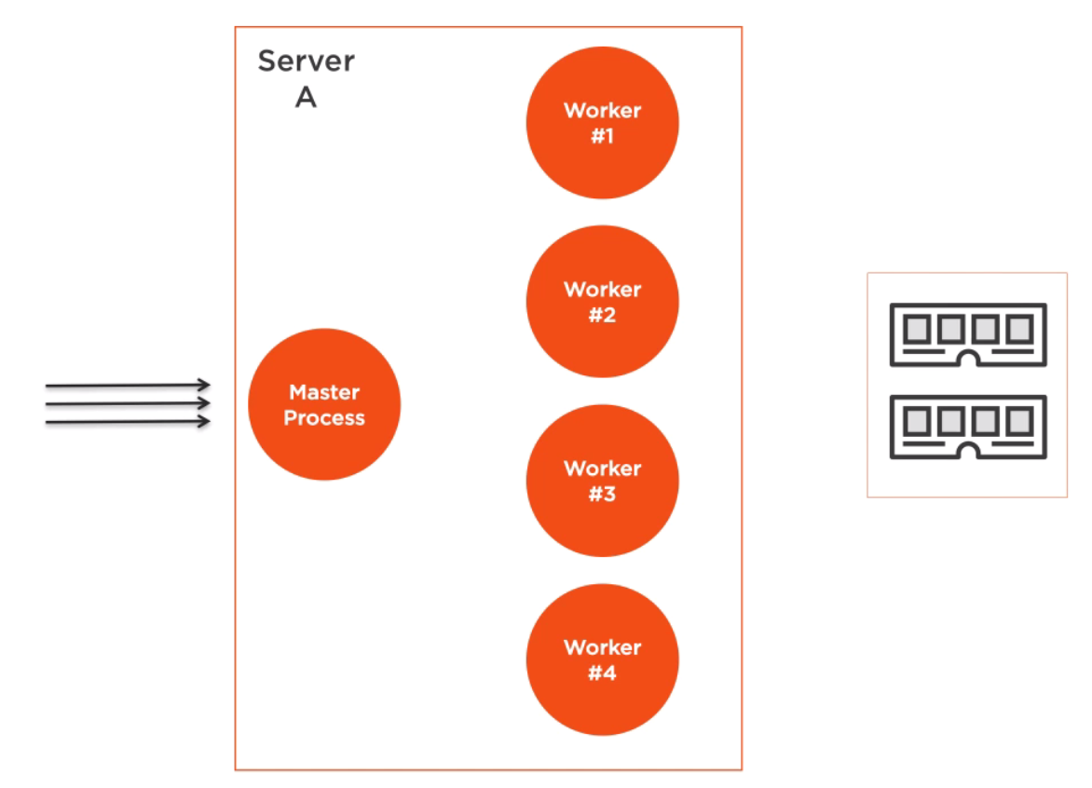
Shared state

Slide 36
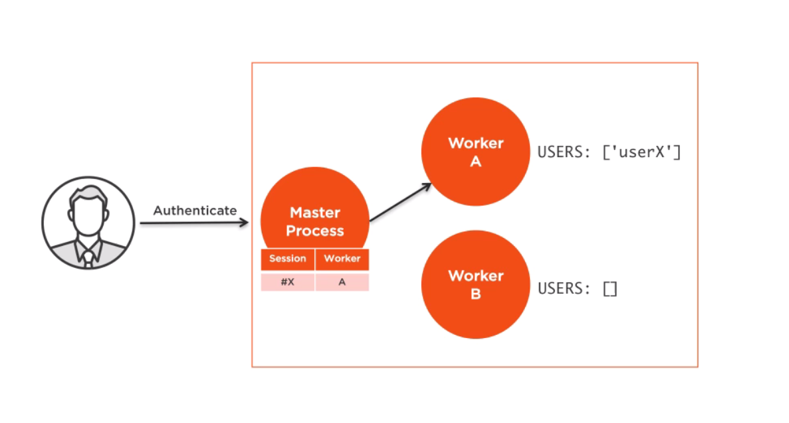
Shared state cluster (sticky load balancing) – Not recommended

Slide 37

Mocking the require

Slide 38
Thank you for attention

